Slide 1
D A T A M I N D S
Capstone Project-04
NETFLIX MOVIES AND TV SHOWS CLUSTERING
Team Name - Data Minds
Team Members- Uday Kant & Sonu Kumar

Slide 2

D A T A M I N D S
Table Of Content
Introduction
Problem Statement
Data Description
Data Wrangling
Exploratory Data Analysis
Data preprocessing
Wordcloud
Removing Stopwords
Removing Punctuation
Stemming
Clustering
PCA
Elbow and Silhouette Method
K-Means Clustering
Inference

Slide 3
Introduction
D A T A M I N D S
Netflix employs data science to always provide us with the appropriate content. They categorise all of the information that people in specific area are now seeing using a clustering and classification algorithm. Also, they employ a recommender system to predicts a person's preferences in the future given a specific quantity of sparse data.
In this project, This dataset consists of tv shows and movies available on Netflix as of 2019. The dataset is collected from Fixable which is a third-party Netflix search engine.
In 2018, they released an interesting report which shows that the number of TV shows on Netflix has nearly tripled since 2010. The streaming services number of movies has decreased by more than 2,000 titles since 2010, while its number of TV shows has nearly tripled. It will be interesting to explore what all other insights can be obtained from the same dataset.

Slide 4
D A T A M I N D S
Problem statements
This project is based on Unsupervised learning and Natural Language processing. We had provided the large dataset in this project and need to perform following problem statements.
Exploratory Data Analysis
Understanding what type content is available in different countries
Is Netflix has increasingly focusing on TV rather than movies in recent years.
Clustering similar content by matching text-based features

Slide 5
D A T A M I N D S
Data Description
The data was collected from Fixable which is third party Netflix search engine. The dataset consists of movies and TV shows data till 2019. The dataset has 7787 rows of data. The dataset consists of eleven text columns and one numeric column.
Attribute/ Features Information :
show_id : Unique ID for every Movie / Tv Show
type : Identiﬁer - A Movie or TV Show
title : Title of the Movie / Tv Show
director : Director of the Movie
5. cast : Actors involved in the movie / show
6. country : Country where the movie / show was produced
7. date_added : Date it was added on Netﬂix
8. release_year : Actual Release year of the movie / show
9. rating : TV Rating of the movie / show
10. duration : Total Duration - in minutes or number of seasons
11. listed_in : Genre
12. description: The Summary description

Slide 6
D A T A M I N D S
Treating with the Null Value
In the given dataset a total of 3631 null value present in which director has the most number of null values then cast has 718 null values then country has 507 null values then date_added has 10 and rating has 7 null values.
Rows of column 'date_added' and 'rating' having null values which can not be filled by mean value or frequent value.
So, we filled all the null values available in dataset with NA which means is (Not Available)

Slide 7
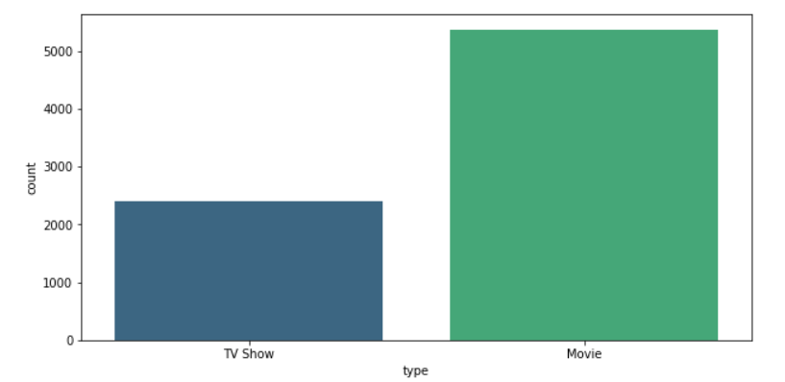
D A T A M I N D S
Exploratory Data Analysis
Before moving towards the EDA part of this project, we checked the type of all the given feature.
Most of the given feature belong to the object type.
1. Types of content available on the Netflix.
Netflix has 5372 movies and 2398 TV shows, there are more number movies on Netflix than TV shows.

Slide 8
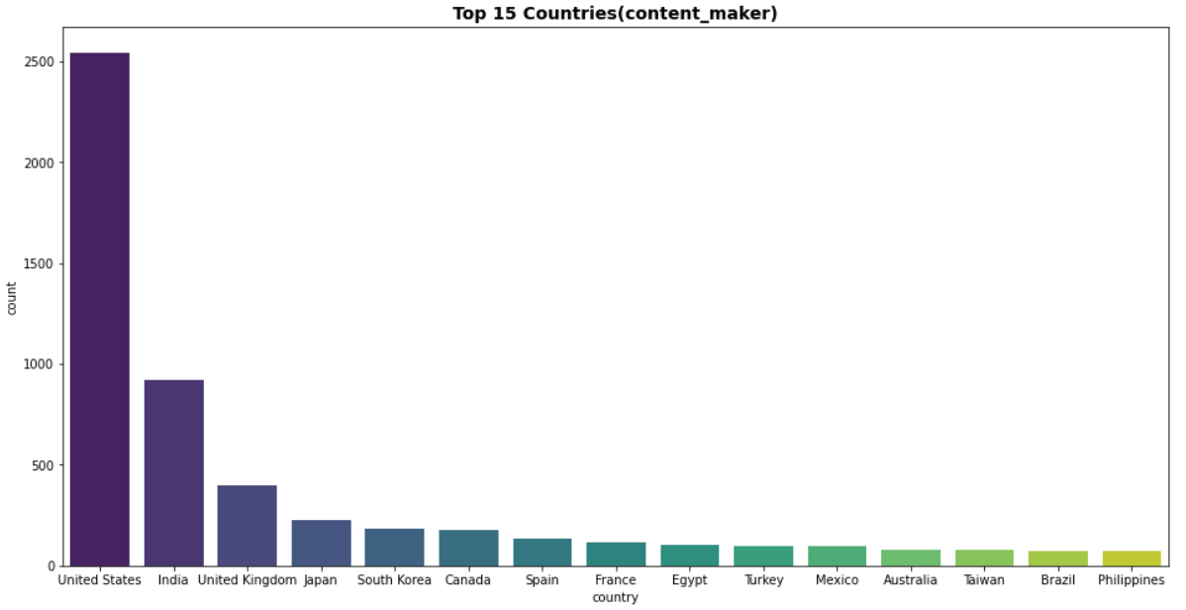
D A T A M I N D S
1. Top 15 countries (Content Maker)
United states has the highest number of content on the Netflix ,followed by India, United Kingdom and so on.
The least country in content maker is Philippines.

Slide 9
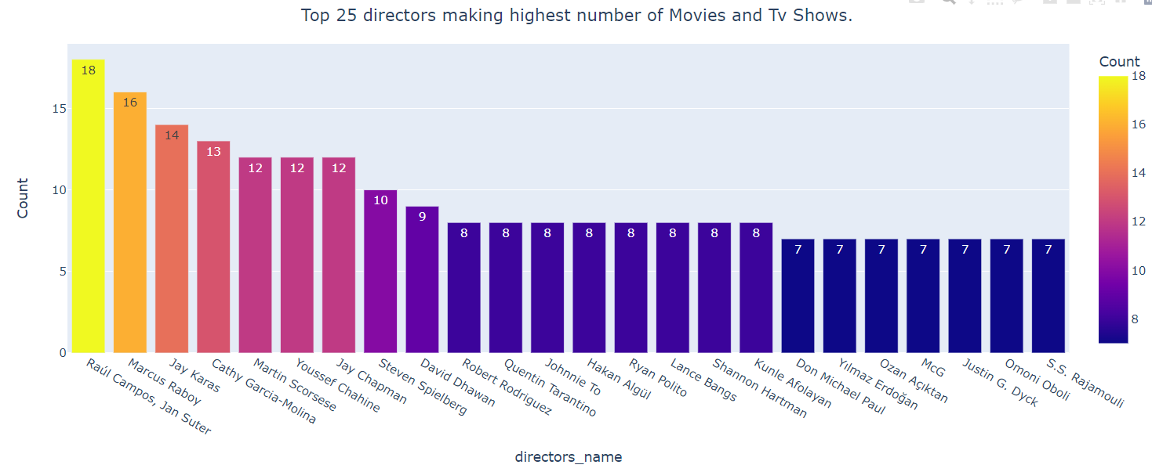
D A T A M I N D S
Top 25 directors making highest number of Movies and Tv Shows
Raul Campos and Jan Suter have the most number of movies and TV shows.
Many directors like Yilmaz Erdogan, McG, and S.S Rajamouli have the least number of movies and TV shows.

Slide 10
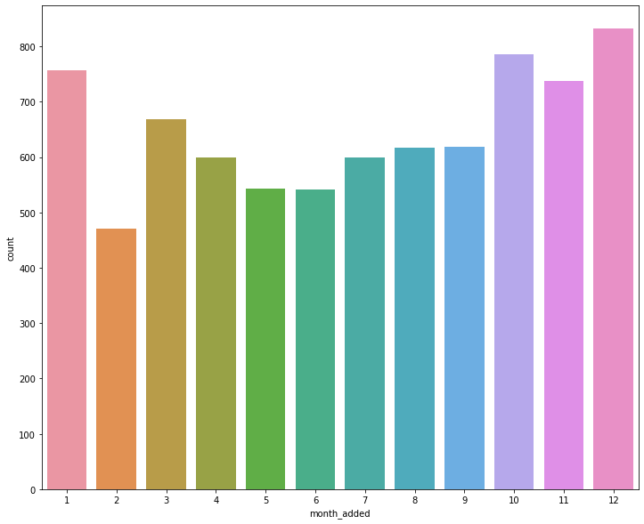
D A T A M I N D S
Release month of the content on the Netflix
Most of the content is uploaded either by year ending or beginning. October, November, December, and January are months in which many shows and movies get uploaded to the platform. It might be due to the winter, as in these months people may stay at home and watch shows and movies in their free time.

Slide 11
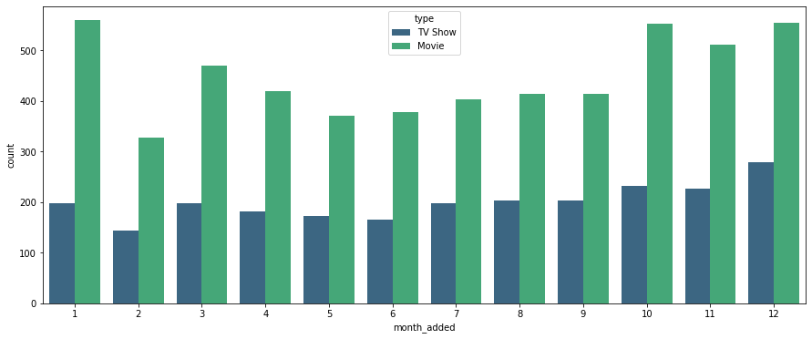
D A T A M I N D S
Category wise Movies and TV shows added in month
From the above graph, we can observe that highest movie added in month January, October, and December. And Highest TV show added in the month of December.

Slide 12
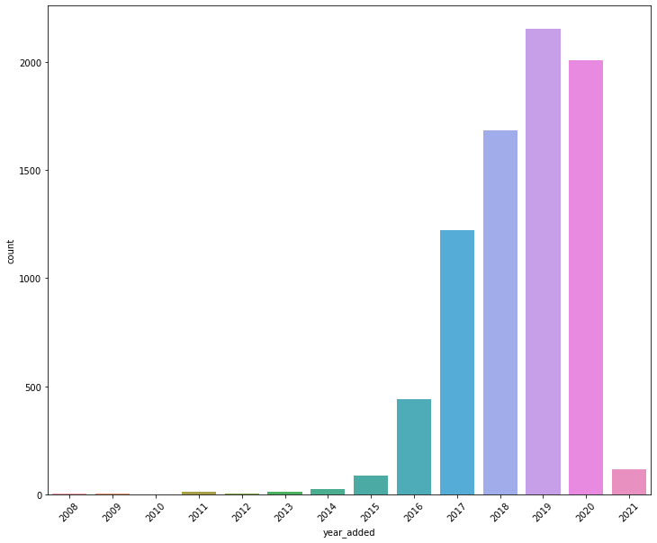
D A T A M I N D S
Content added in years in the Netflix.
2019 is the year when most of the contents are added in Netflix. And it become reducing after 2019.
We can observe that in 2021, there were less than 500 content added in the Netflix.

Slide 13
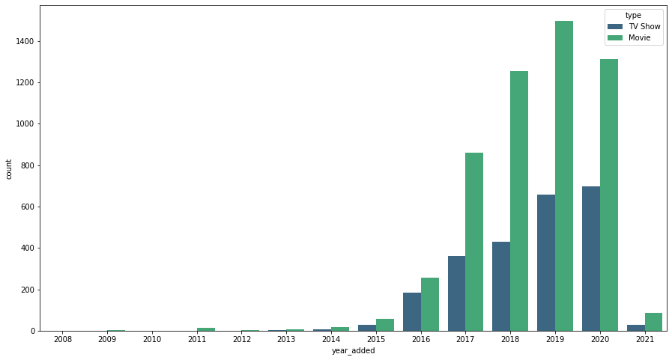
D A T A M I N D S
Category wise Movies and TV shows added in years
From this graph, we can observe the trend that there are increment in movie as well as TV shows from year 2017 to 2019. But after 2019, there is decrement in Movie but increment in TV shows.

Slide 14
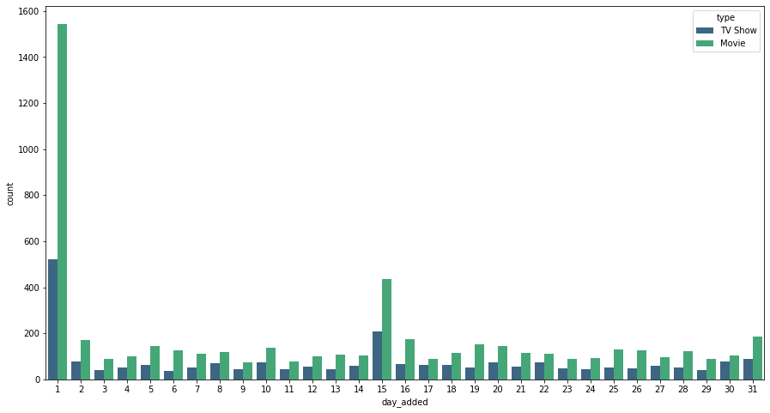
D A T A M I N D S
Category wise Movies and TV shows added in dates
From the above graph we can assume that most of the contents added on the first of the month followed by 15th and 31st.

Slide 15
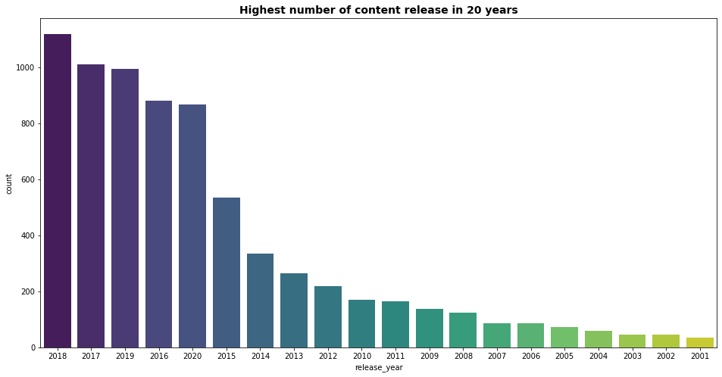
D A T A M I N D S
Highest Number of content release in the year
From the above graph, we can observe that in year 2018, most numbers of the content was released and least number of content in the year 2021.

Slide 16
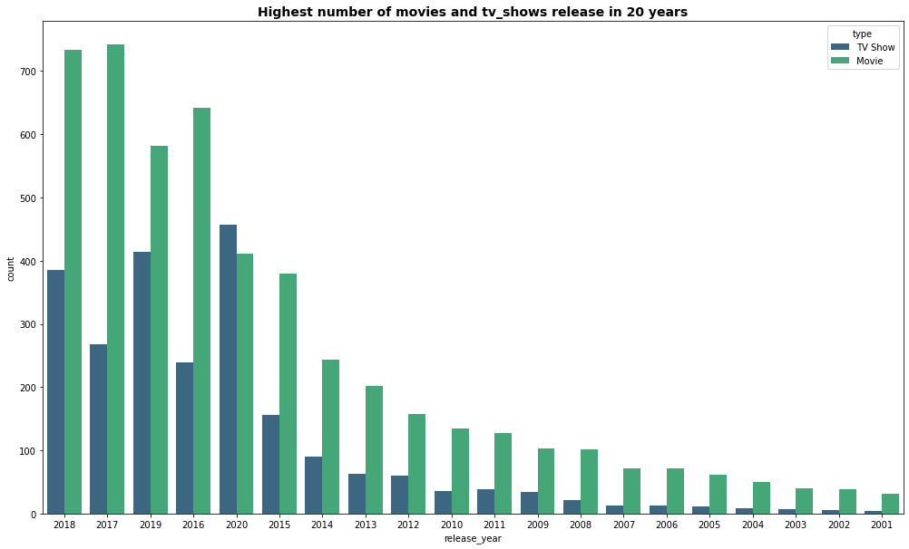
D A T A M I N D S
Highest number of movies and tv_shows release in 20 years
From the above graph we can see 2018 is the year in which most no. of the movies are released and in 2020 most of the tv_shows are released.

Slide 17
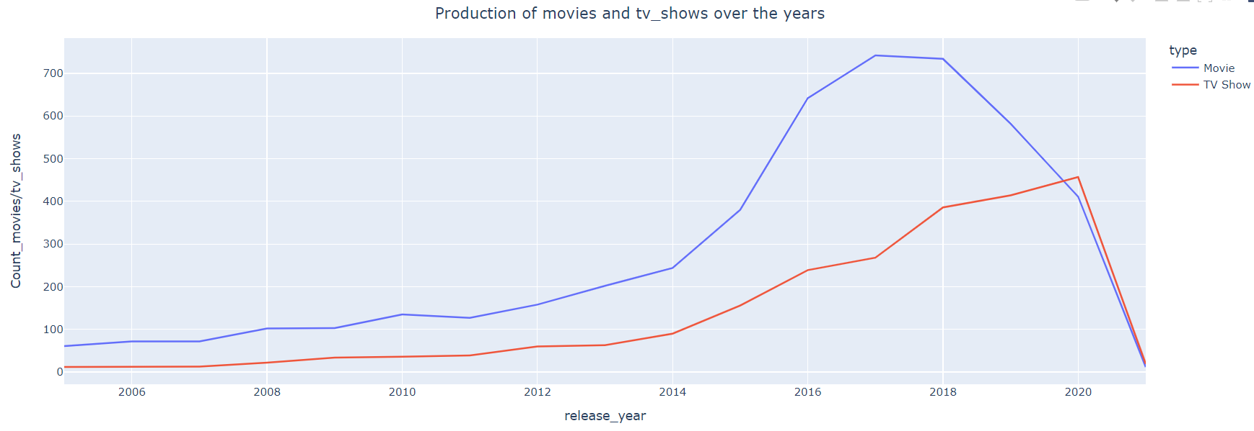
D A T A M I N D S
Production of movies and TV shows over the years
Compared to TV series, the quantity of Netflix movies is increasing noticeably more quickly.
After 2015, we noticed a significant rise in the quantity of films and television programs.
After 2020, there is a sharp decline in the volume of films and television programs made.
It looks that Netflix has prioritized adding more movie material over TV shows. The growth of movies has
been far more pronounced than that of TV shows.

Slide 18
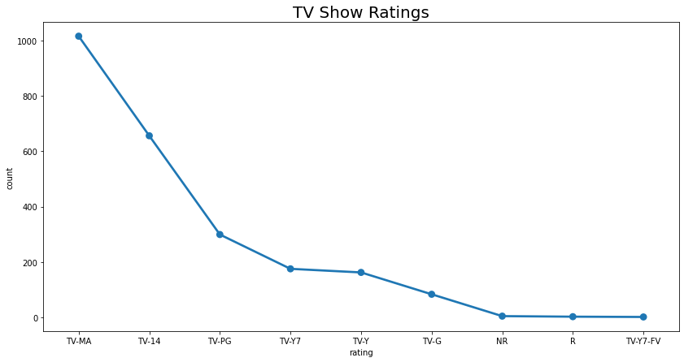
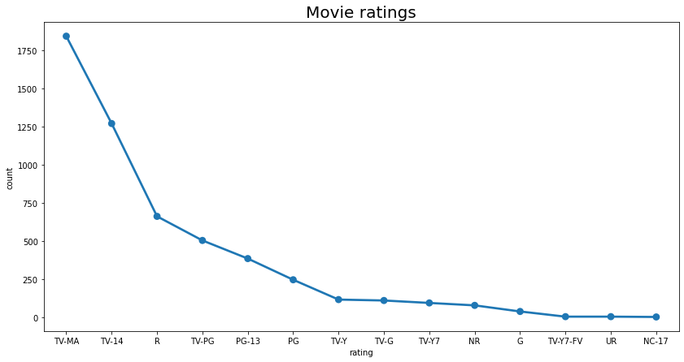
D A T A M I N D S
Ratings for TV_shows and Movies
From the above graph, we can observe that the most rated
TV_shows rating is TV-MA and the least rated Tv_show is TV-Y7-FV
From the above graph, we can observe that the most rated
Movie on the Netflix is TV-MA and the least rated movie on
The Netflix is NC-17.

Slide 19
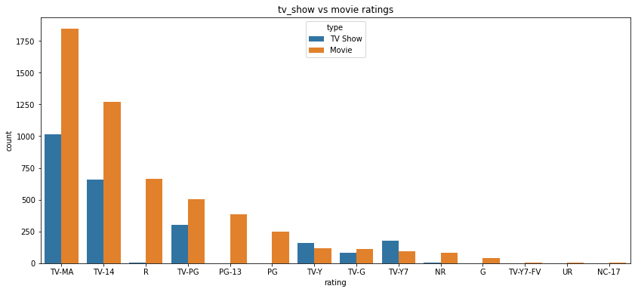
D A T A M I N D S
TV shows VS Movie ratings
We can see that both movies and tv_shows got the highest rating as TV-MA. TV-MA belongs to mature content, so
we can say most popular category belongs to mature content.
Then it is followed by TV-14 and TV-PG and this is belongs to Teen and older kids category.
Here some contents got least rating belongs to NC-17 and TV-Y7-FV categories.
Overall conclusion of the above graph is most of the content belongs to mature, teen and older kids category.

Slide 20
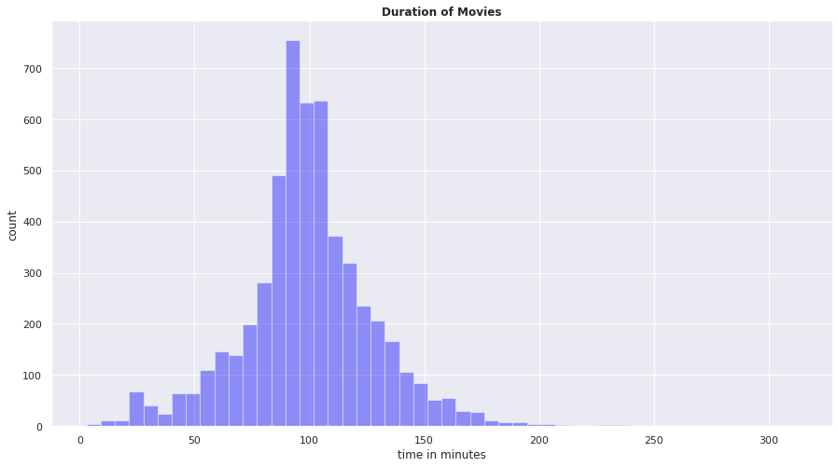
D A T A M I N D S
Graph for duration of the movies.
For this graph, we can observe that more than 600 movies have duration lies between 80 to 120 minutes.

Slide 21
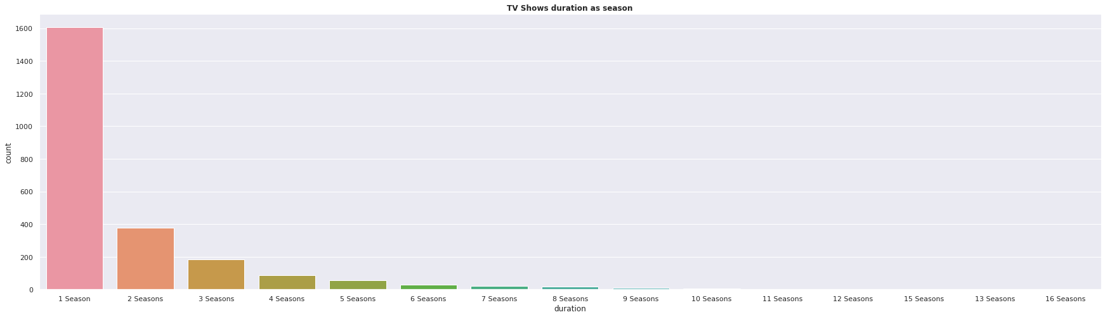
D A T A M I N D S
TV shows duration as seasons
From this graph, we can observe that tv shows have only one session are most
demanding TV shows.
As the number of seasons are increasing interest are decreasing among the viewers.

Slide 22
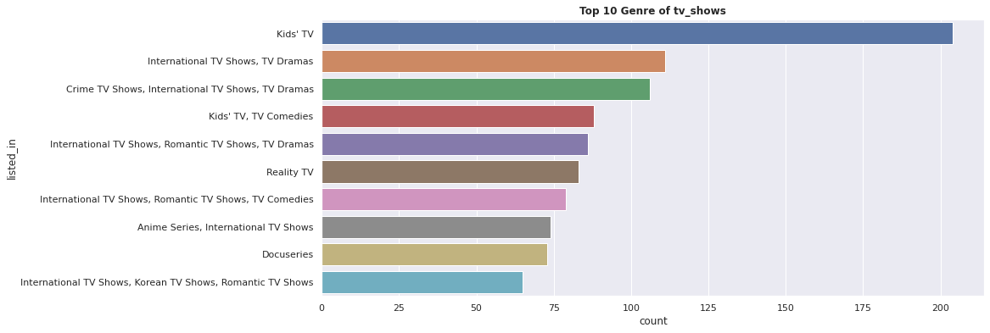
D A T A M I N D S
Top 10 Genre of TV shows
From this graph, we can observe that Kid's TV shows have the most number occurring, which is more than 200 times.
International TV shows, Korean TV shows, and Romantic TV shows have the least number of count that is approx. 60

Slide 23
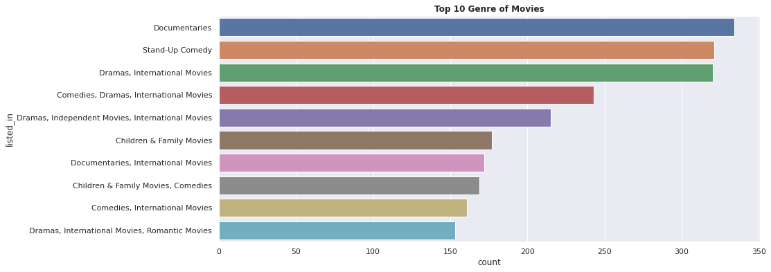
D A T A M I N D S
Top 10 Genre of Movies
From this graph, we can observe that the movies based on Documentaries have the most
number of count approx. 330.
Stand Up comedy, Drama, International movies are occurring with the same number which is
approx. 310
Dramas, International movies, and Romantic movies have the least number of occurring which
is more than 150.

Slide 24

D A T A M I N D S
Natural Language Process
Natural Language Processing (NLP) is a subfield of artificial intelligence (AI). It helps machines process and understand the human language so that they can automatically perform repetitive tasks.
Data Preprocessing
To prepare the text data for the model building we perform text preprocessing. It is the very first step of NLP projects. Some of the preprocessing steps are:
Removing punctuations like . , ! $( ) * % @
Removing URLs
Removing Stop words
Lower casing
Tokenization
Stemming
Lemmatization

Slide 25
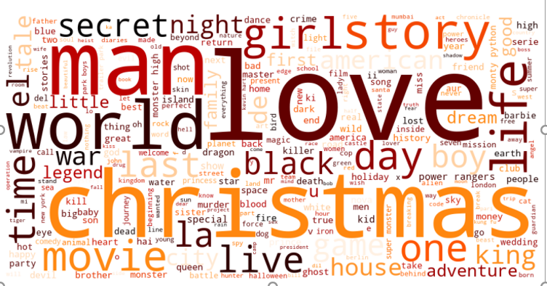
D A T A M I N D S
Most words used in Title
Most frequent word in title column are love, Christmas, man, girl, world, life etc.
We can conclude that most of the movies and tv_shows release in december so christmas
appears most of the time.

Slide 26
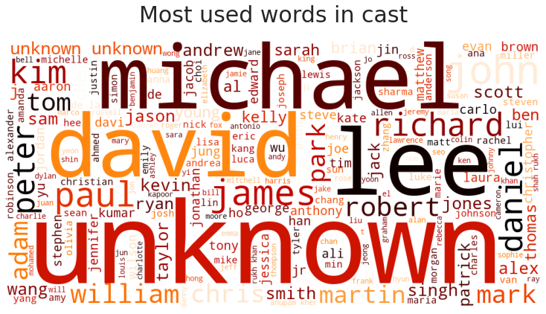
D A T A M I N D S
Most used words in cast
Here we can see the most number of cast are not available(unknown) in the dataset then Michael, David, John, Lee, James, etc.

Slide 27
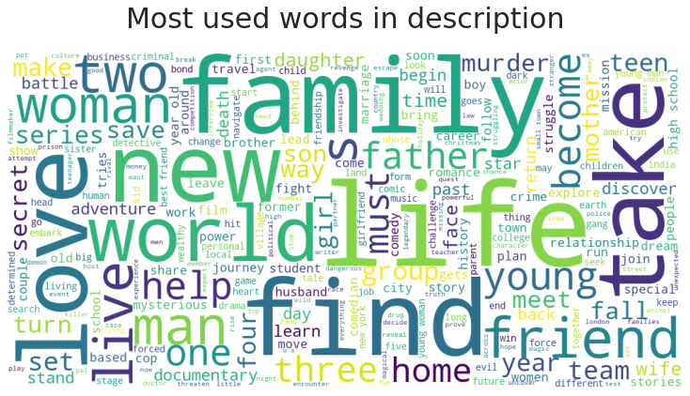
D A T A M I N D S
Most used word in description
Here we can see most of the words in the description of the tv shows and movies are Family, Friend, Love, Life, World, Man, Woman, Father, etc.

Slide 28
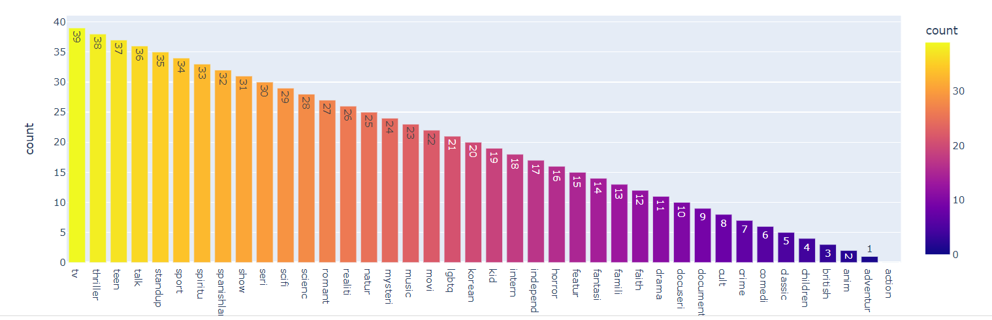
D A T A M I N D S
Frequent words present in listed_ in column
From the above graph, we can observe that most frequent word used is tv, then thriller and least popular category is adventure and action on Netflix.

Slide 29
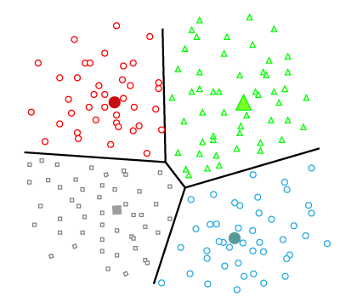
D A T A M I N D S
Applying Clustering
Clustering is the task of dividing the population or data points into a number of groups such that data points in the same groups are more similar to other data points in the same group and dissimilar to the data points in other groups.
Here, we create clusters of text columns of our data set so that we can apply TfIdf Vectorizer on clustered data (document).
After that Tfidf Vectorizer weights the word counts by a measure of how often they appear in the document.

Slide 30
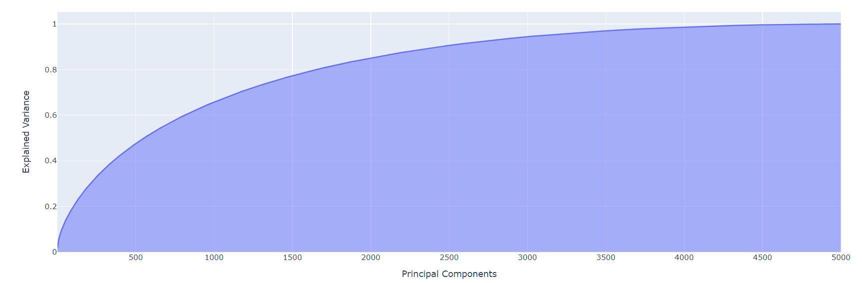
Applying PCA for dimensionality reduction
Using PCA for dimensionality reduction. PCA reduces data by geometrically projecting them onto lower dimensions called principal components (PCs), with the goal of finding the best summary of the data using a limited number of PCs.
Here we can see almost 95% of variance is explained by approx.. 3000 component.
So we take 95% to select approx.. 3000 principal components.

Slide 31
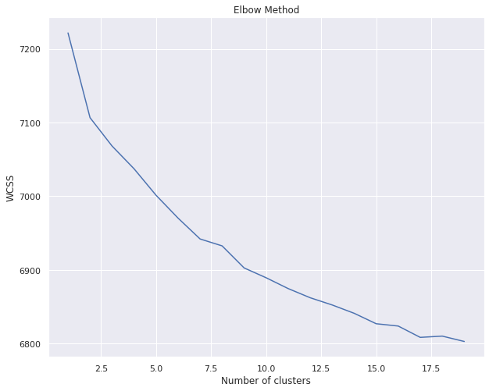
D A T A M I N D S
Applying k-Means Algorithm
At first we use elbow method for finding the optimum value of k.
The silhouette value is a measure of how similar an object is to its own cluster compared to other clusters (separation). The silhouette ranges from −1 to +1, where a high value indicates that the object is well matched to its own cluster and poorly matched to neighboring clusters.

Slide 32
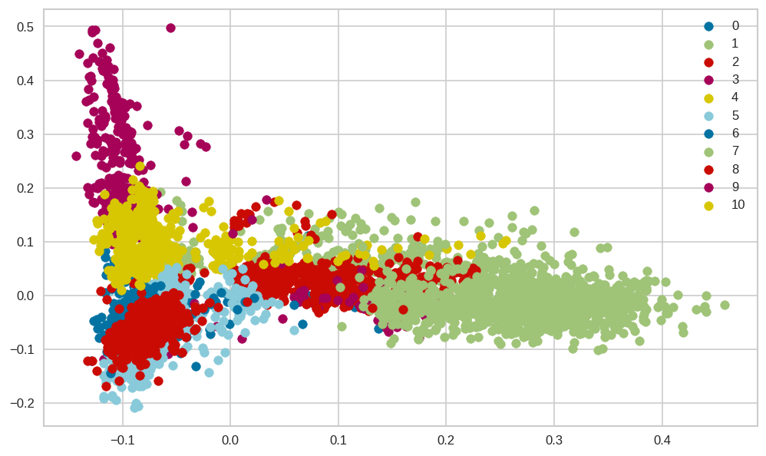
D A T A M I N D S
After analyzing all silhouette plots we choose k=11 and then cluster the all data.

Slide 33
D A T A M I N D S
Inference (i)
In this given dataset of Netflix there are total of 7787 rows and 12 columns.
There are some null values present in some features like director, cast, country, data added, release year and rating.
After analysing netflix dataset, it shows 5372 movies and 2398 tv_shows.
There are more number of movies than tv_shows present on netflix.
In USA number of content released or added is highest followed by india.
Most of the content were added in 2019 on netflix. We can also observed that most of the movies were added in 2019 and tv_shows in 2020.
After year 2018 the popularity of tv_shows increases with respect to movies.

Slide 34
D A T A M I N D S
Inference (ii)
TV-MA has the highest rating for both movies and tv_shows which shows that mature and teen content is most popular on netflix. Least rating for tv_shows is TV-y7FV and movie is NC-17 which is a adult category.
The highest duration of the movies lies between 80 to 120 minutes and most of the popular tv_shows having only 1 season.
After that we use NLP on the text columns of our dataset in which we perform punctuation removal, removing of stopwords and then stemming.
After doing all that we do Tf-Idf on listed_in(genre) and description column.
So we can conclude that frequent words of listed_in are tv, thriller, teen and least frequent words are adventure, action. So the popularity of tv_shows is higher than any genre of the movies. in movies most popular genre is thriller followed by teen.
We apply Tf-Idf on clustered data which is corpus of words. Then we do PCA for dimensionality reduction.
Then we apply clustering. For finding optimum value of k we use Elbow method and silhouette method. After that we apply clustering so that we obtain the best clustering arrangement.
From all the analysis we have done, we can improve the future content quality of the netflix i.e which type of content is popular among the citizens and of which genre and duration etc.

Slide 35
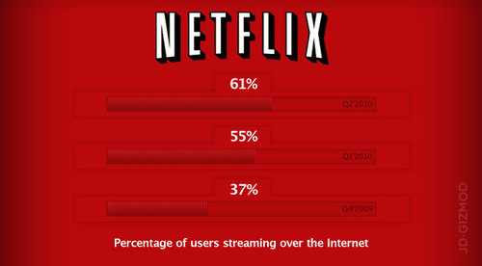
D A T A M I N D S
Future Scope
From EDA part we can use analysed information to reduce the churn rate by making more suitable content for any individual customer and this can increase the economical growth of the Netflix.
Clustering analysis of this dataset can be useful for creating movie recommender system.

Slide 36
D A T A M I N D S
Thank You !!

